Slide 1
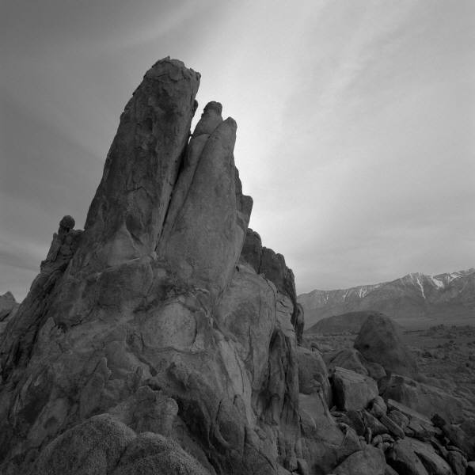
WORDS OFTEN CONFUSED
TIME TO CORRECT THINGS!

Slide 2

Yes YOU Can!

Slide 3
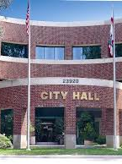
CAPITAL
VS.
CAPITOL

Slide 4
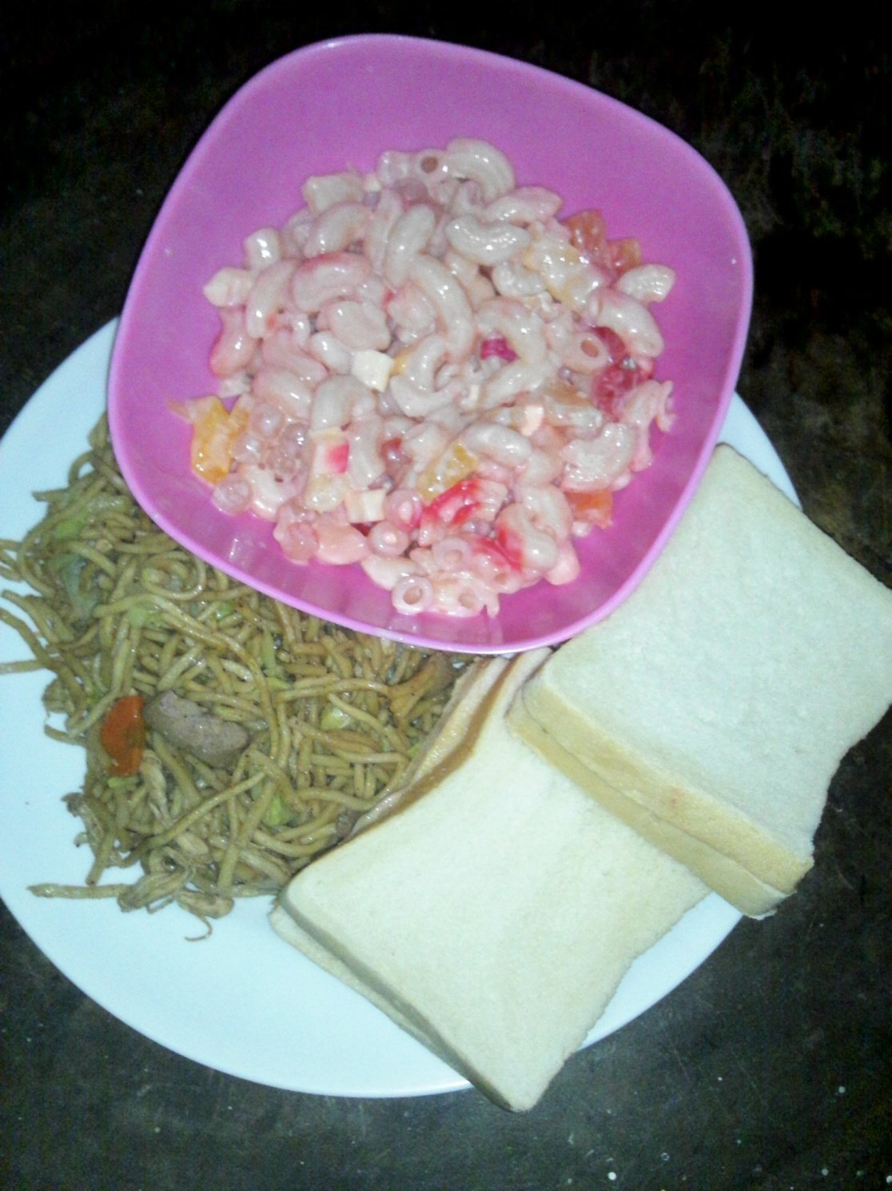
DE’SERT
DESERT’
DESSERT

Slide 5
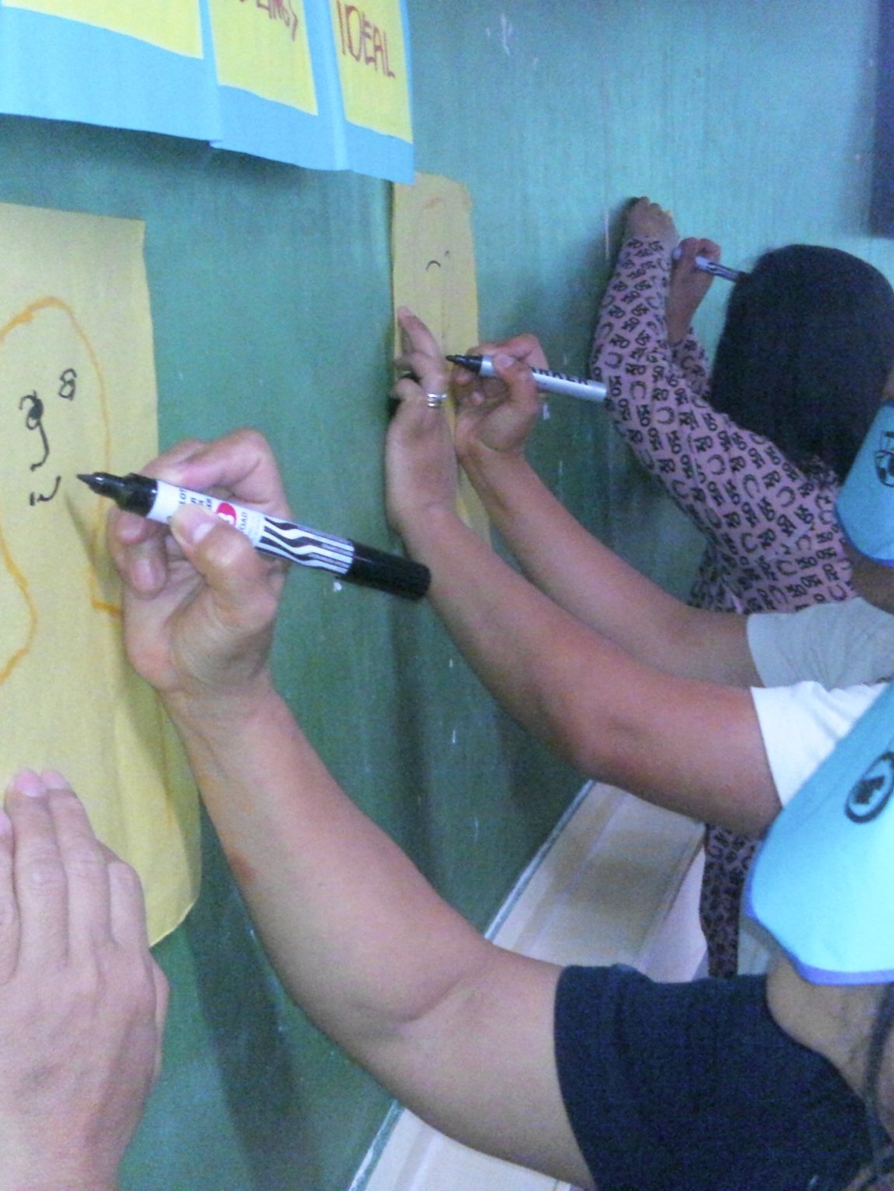
HEAR
HERE

Slide 6

ITS
IT’S

Slide 7
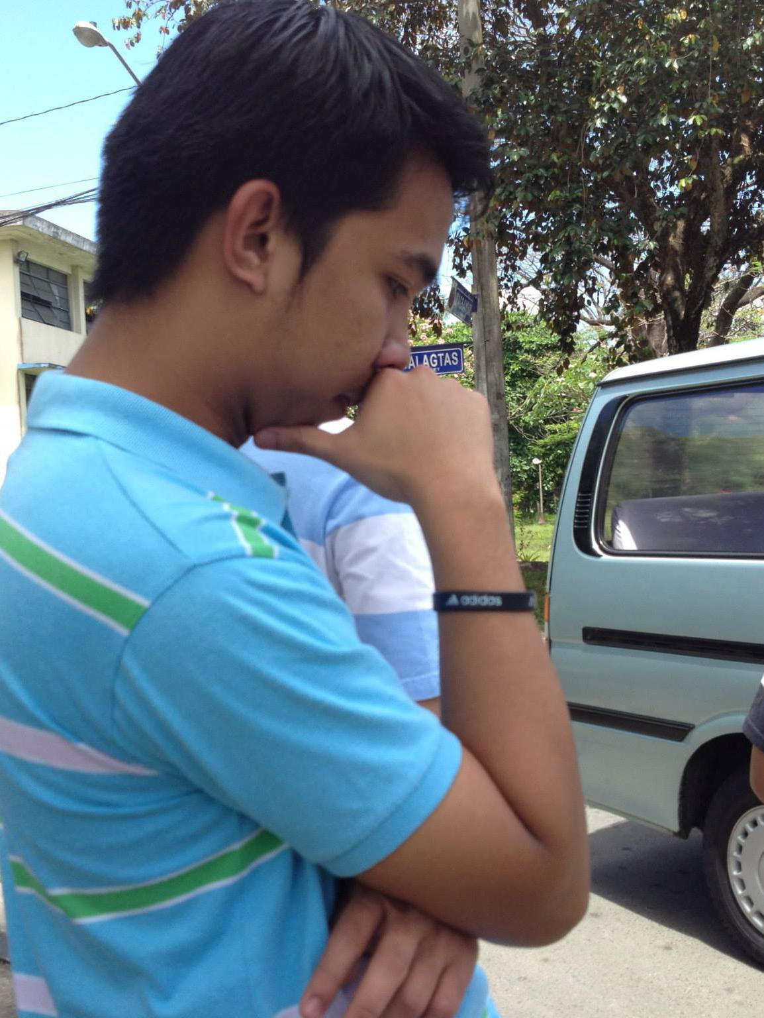
LOOSE
LOSE

Slide 8
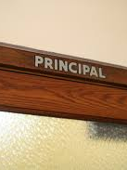
PRINCIPAL
PRINCIPLE

Slide 9
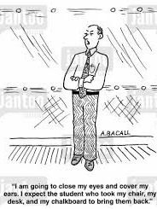
STATIONARY
STATIONERY

Slide 10
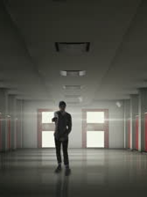
THEIR
THERE
THEY’RE

Slide 11
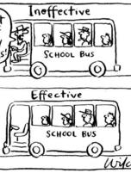
TO
TOO
TWO

Slide 12
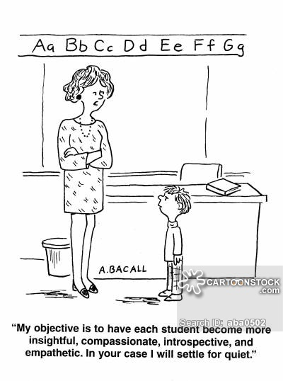
WEATHER
WHETHER

Slide 13
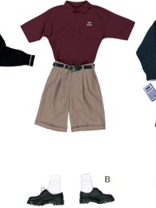
WHO’S
WHOSE

Slide 14
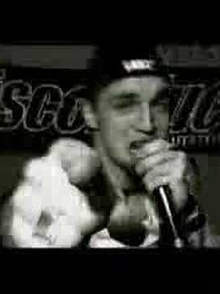
YOUR
YOU’RE

Slide 15
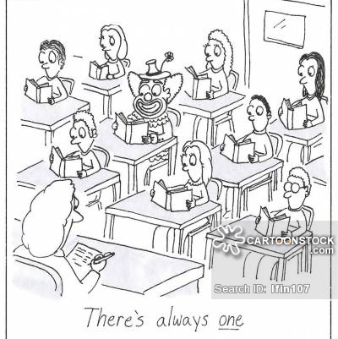
Verbs often confused
WHICH IS WHICH?

Slide 16

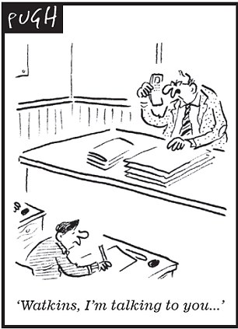
LIE
LAY

Slide 17


RISE
RAISE

Slide 18
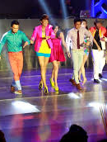
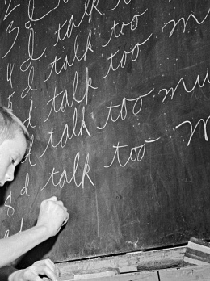
AFFECT
EFFECT

Slide 19
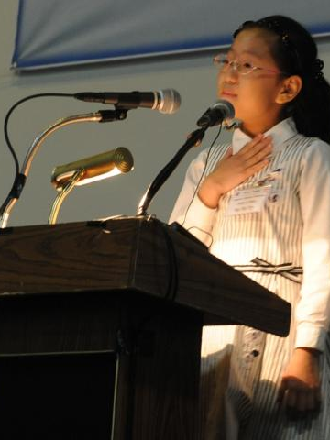
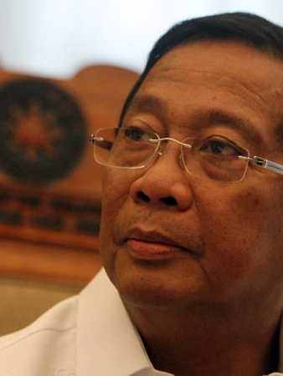
ADVISE
ADVICE

Slide 20
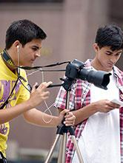
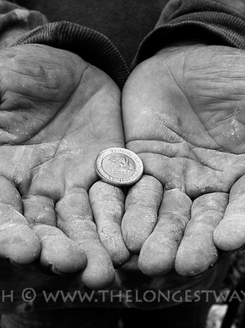
BORROW
LEND

Slide 21

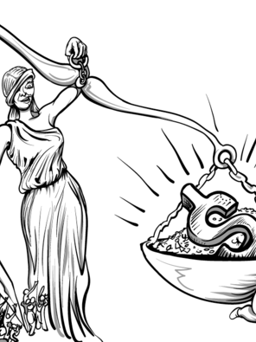
BRING
TAKE

Slide 22

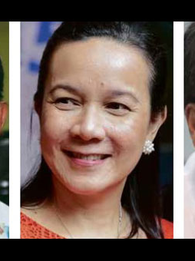
DISINTERESTED
UNINTERESTED

Slide 23

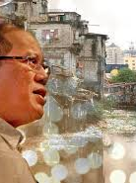
CONDEMN
CONDONE

Slide 24


PERSECUTE
PROSECUTE

Slide 25
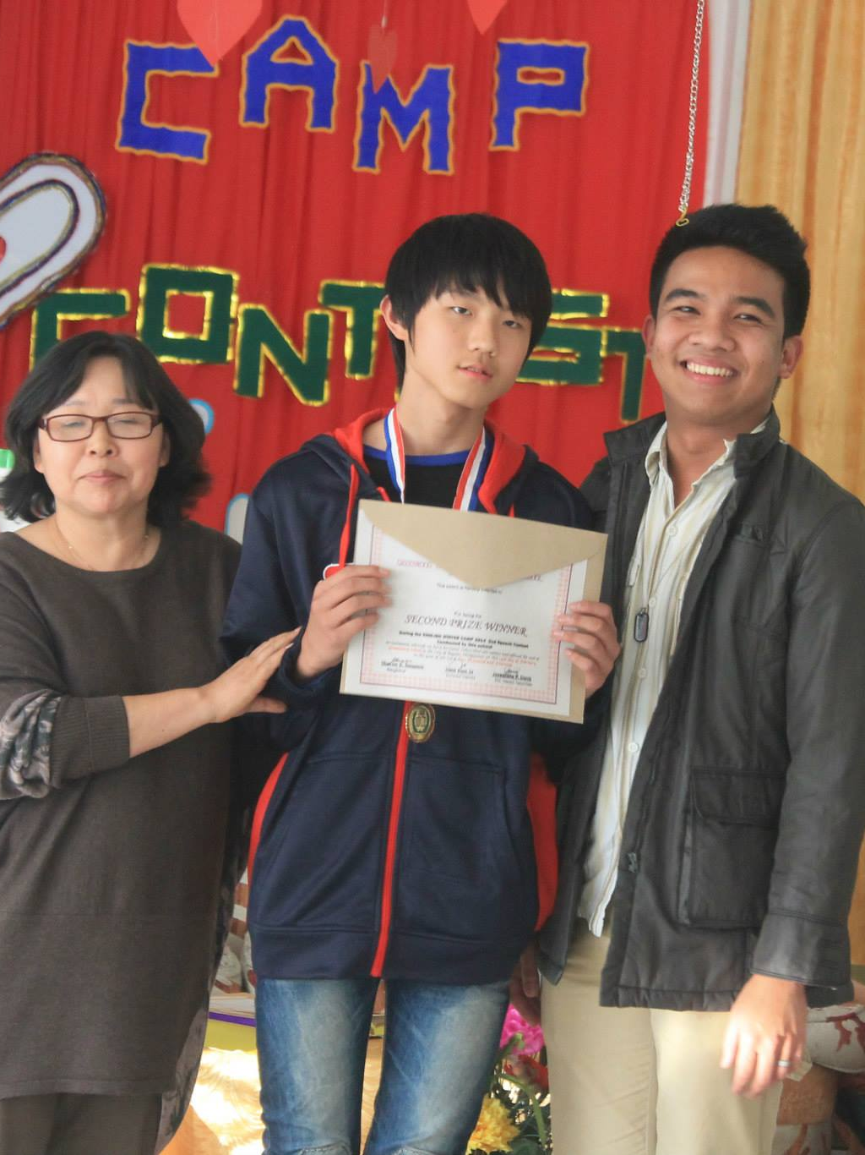

ACCEPT
EXCEPT

Slide 26
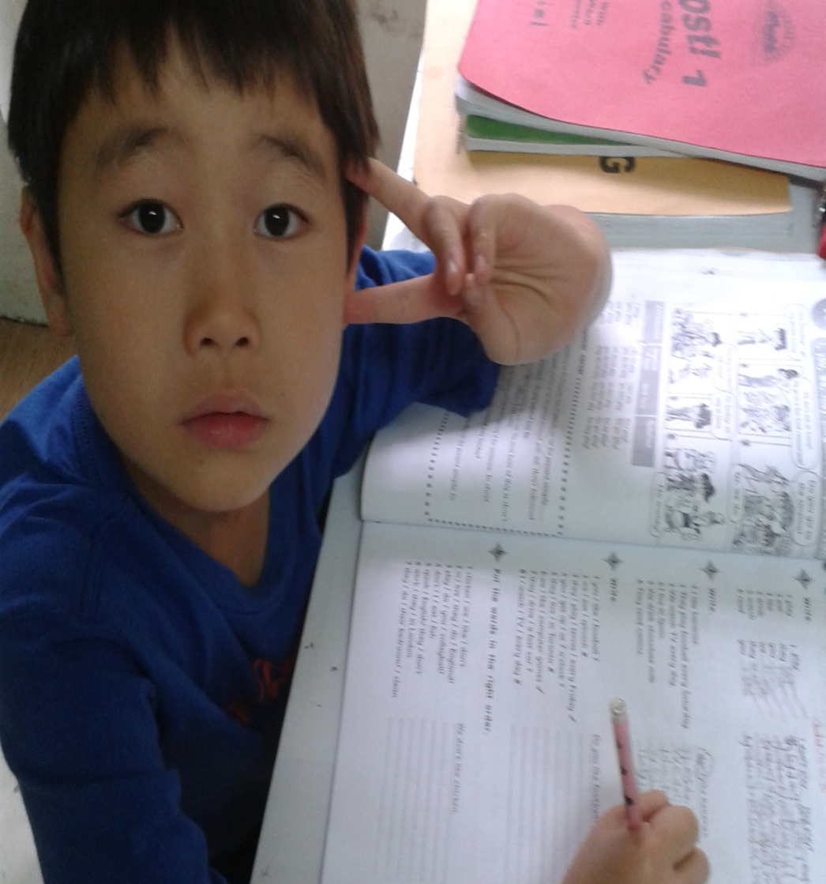
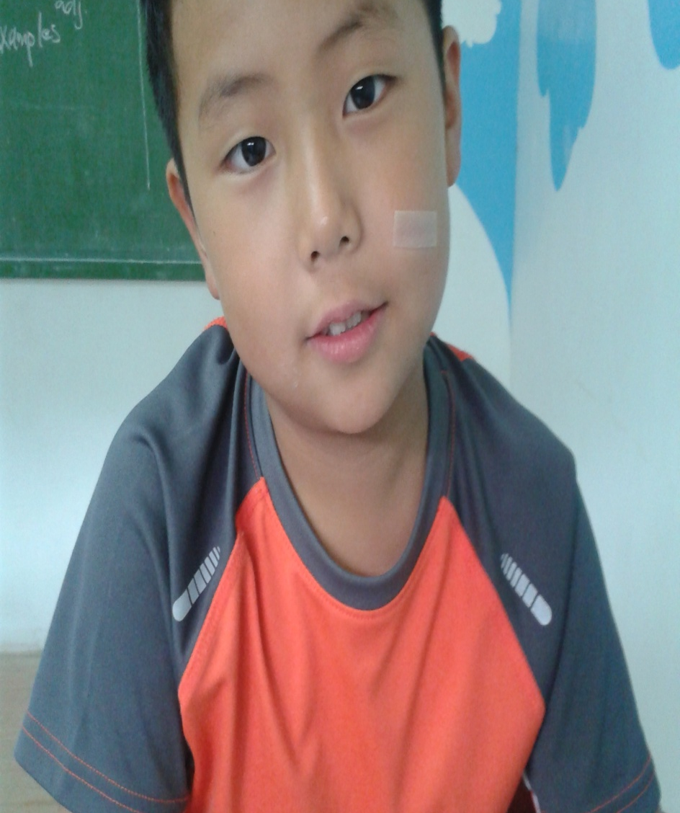
EMIGRATE
IMMIGRATE

Slide 27

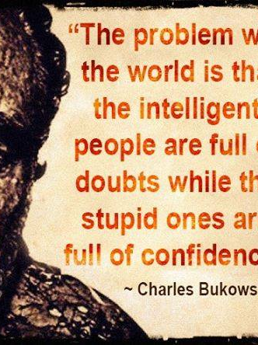
IMPLY
INFER

Slide 28
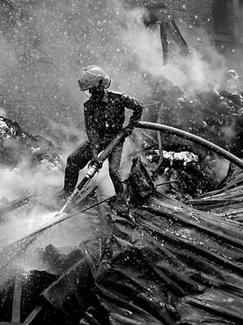
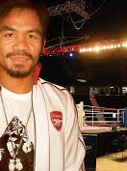
ACCUSE
ALLEGE

